Slide 1

Dr.B.R.Ambedkar University, Srikakulam
College of Engineering
Department of Computer Science and Engineering
PROJECT REPORT

Slide 2

E- Agri
PRESENTED BY:
K. PARVATHI PRASAD
CH.DIVYAKUMARI
K.HARIKA
A.CHANDRASEKHAR
UNDER THE GUIDANCE OF Mr.SRIDHAR SIR

Slide 3
ABSTRACT
E-AGRI is a web based application which is useful for farmers and agricultural students. It is farmer friendly. Now-a-days farmers don't have a better idea about how to cultivate the crops in a better way. This website has detailed information about the crops and seasonal crops. This is an open discussion portal providing solutions to small farmers and agricultural students. It also provides soil analysis for all regions and suggestions on which fertilizers to use where and how much? And which crop, herb or vegetable to be grown where and in which season? It also helps to make decisions on market and best prices. It provides information about crops, fertilizers, and market details.

Slide 4
INTRODUCTION
This is the agricultural portal which provides solutions to small farmers and agricultural students.
It also helps the NGO’s to get valuable information regarding soil and
fertilizers and also crops.
It also helps the agricultural students to get practical information regarding
various crops.
It also helps the farmers through NGO’s to get information regarding crops,
in awareness programs being conducted in villages.

Slide 5
OBJECTIVE
• The main objective of the project is to provide information to the farmers and agricultural students.
• It provides better solutions for farmers in providing the information regarding soils, fertilizers.
• It helps the users in giving awareness regarding various technologies that can be used in farming.

Slide 6
EXISTING SYSTEM
Complexity in managing the data related to agricultural products , soils, fertilizers, and market details
• Lack of security
• This system doesn’t provide category wise classification of products.
• Inefficiency in querying details.
• Periodic report generation takes lot of time

Slide 7
PROPOSED SYSTEM
The development of this new system contains the following activities, which try to automate the entire process keeping in the view of database integration approach.
• Reduce complexity in managing the data related to agricultural products , soils, fertilizers, market details.
• Current system provides different access levels for security.
• Rich user interface is provided in order to interact with application.
• Reports are generated dynamically on a periodic basis.
• Efficiency in giving details.
• Detailed information about farming are maintained.

Slide 8
SPECIFIC REQUIREMENTS
Functional Requirements:
Individual profile management for all kinds of users.
Basic soil analysis for all regions and suggestions on which fertilizers to use where and how much? Which crop, herb or vegetable can be grown where and in which season?
Online query handlings for all users. Queries can be directed to a particular officer.
Officers/ngo’s can schedule trainings and publish it online.
Facilitate communication between user and general public through mails.
Information about major crop markets and their current price for crop should be published daily.
Information pages should be dynamic .

Slide 9
Non Functional Requirements:
• Secure access of confidential data(user’s details).
• Better component design to get better performance at peak time.
• Flexible service based architecture will be highly desirable for future extension.
User Interface Requirements:
s:
• Professional look and feel.
• Browser testing and support for IE.
• Reports exportable in .XLS, or any other desirable format.

Slide 10
SYSTEM REQUIREMENTS
Software Requirements:
Operating System : Windows XP User interface :HTML/CSS
Client-side:JavaScript
Scripting Web Applications : JDBC, Servlets , JSP
DataBase: Workbench
Server Deployment: Tomcat 5.0
Hardware Requirements:
Processor : Pentium IV Hard disk : 40GB
RAM : 512MB or more

Slide 11
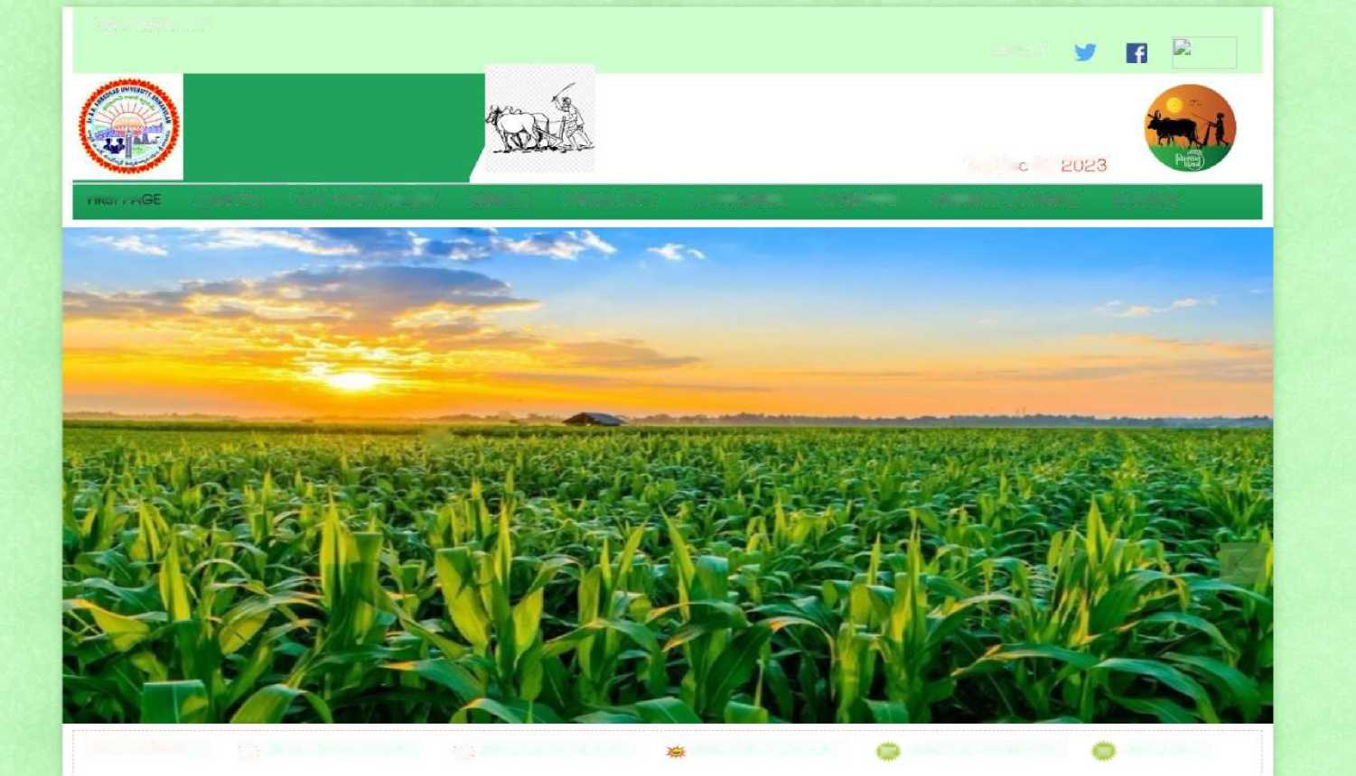
FIRST PAGE
CAPTION HERE
RTI.'ACT
Thu
DS '
07
- - -
rirx: t d a
ABOUT US CROP MANAGEMENT SCHEMES MOBILE-APPS E-AGRICULTRE MACHINERY SUBSIDARY BRANCHES CONTACT
s
FLASH NEWS: ;_s ^ ADD A PDF OR DETAILS jg» ADDA PDF OR DETAILS ADD A PDF OR DETAILS H ADD A PDF OR DETAILS IK ADD A PDF C

Slide 12
THE INFORMATION OF E-AGRI:
IMPORTANT LINKS
AGRI CHANNEL
CHANNEL VIDEOS
AGRICULTRE
ANIMAL HUSBANDRY
HORTIUCULTRE
FISHERIES
SERICULTRE
CROPS OWNERSHIP
INTER CROPS
SRIVARISAGU
PLANT PROTECTION
ORGANIC FARMING
MACHINERY
SOIL TEST
'MARKET PRICES
THE WEATHER
ADD FEATURE

Slide 13
OUR DISTANT VISION
Our ambition is to make agriculture profitable and able to withstand international competition and to improve the living standards of the farmers of Andhra Pradesh.
OUR WILL
Strengthening the rural economy by providing high-demand services to farmers and helping them shift from subsistence agriculture to commercial agriculture without harming the balance of nature.
To create profitable and sustainable agriculture that can withstand International competition by promoting diversified crops, adding value to products and providing necessary market facilities.
OUR INTENTIONS
To achieve a growth rate of 5 percent and above in agriculture by increasing crop production and productivity through effective technology transfer and adoption by farmers.
To reduce cost of production through biological methods, increase farmers' agricultural income and empower farmers to use land and water resources sustainably.
To prepare the necessary plans and instructions to face the challenges faced in the development of the agriculture sector and to formulate specific procedures and directions for the agriculture department.

Slide 14
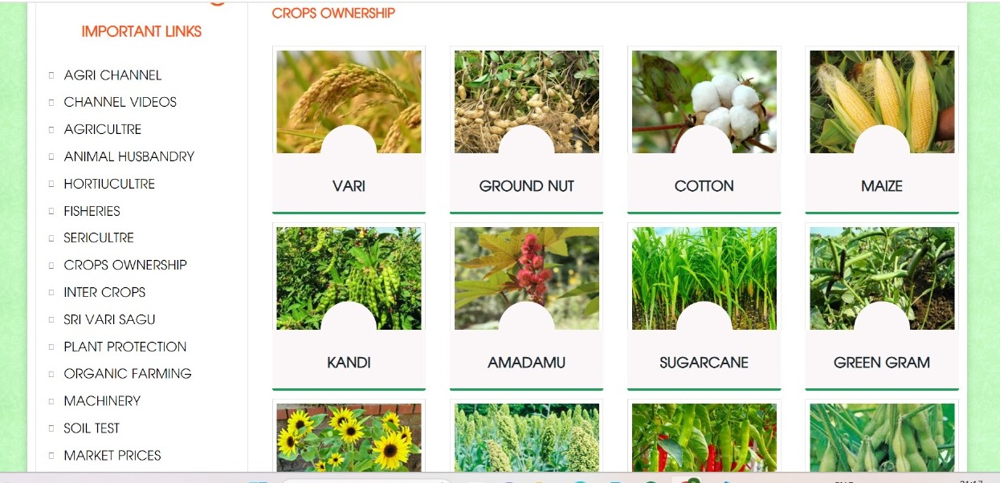

Slide 15
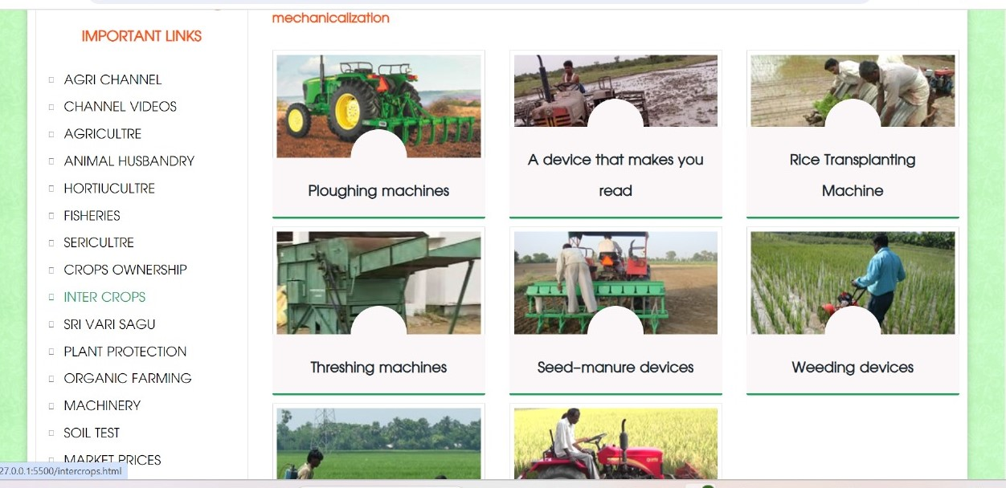

Slide 16
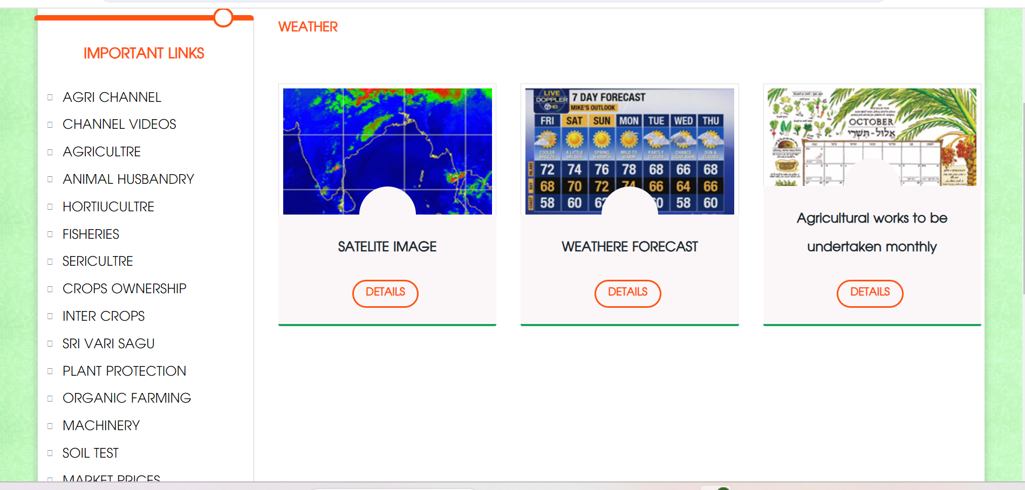

Slide 17
STRENGTHS:
• Good look and feel
• It provides valuable and valid information regarding soils, crops and fertilizers
• Awareness is also provided for users regarding technologies that can be used in farming.
• The users can also search their interested crops information that can be answered by the website.
WEAKNESS:
• Lack of security.
• Not directly useful for farmers

Slide 18
CONCLUSION:
• By this project, we provide various information regarding soil, crops, fertilizers for farmers and also for the agricultural students.
• It makes agriculture more eco-friendly.
• Every farmer can understand the farming process.
THANK YOU

